Slide 1
.NET Core

Slide 2
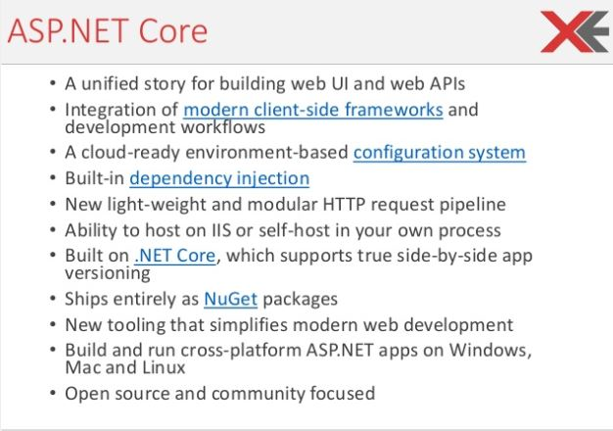

Slide 3
Important Features
Cross platform compatibility
Flexibility of being open source
Hosting independence
Built-in support for dependency injection
Support for JSON based configuration

Slide 4
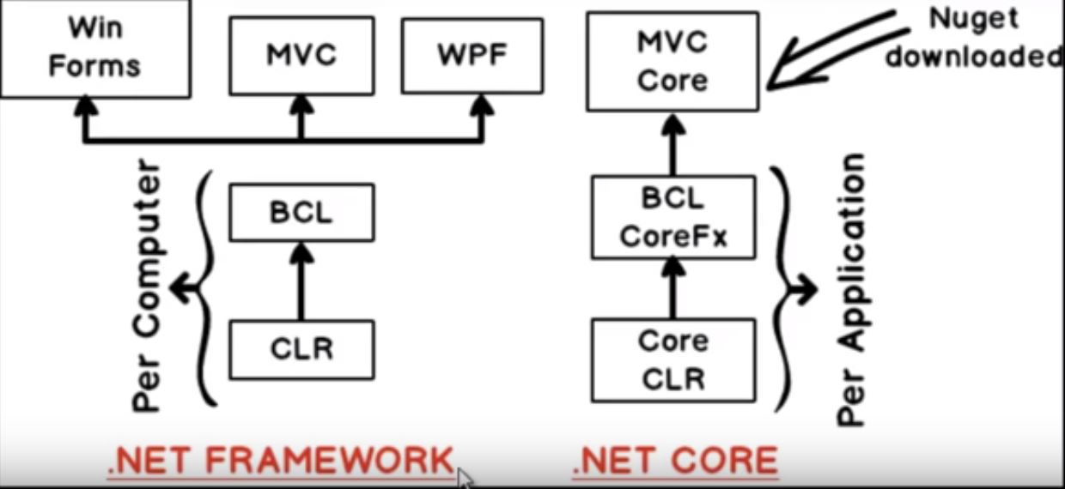
.NET Framework and MVC Core

Slide 5
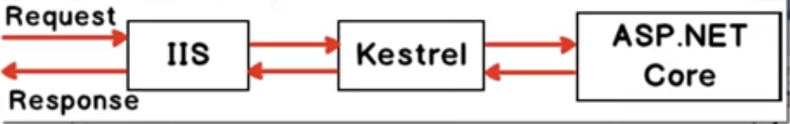
IIS and Kestrel

Slide 6
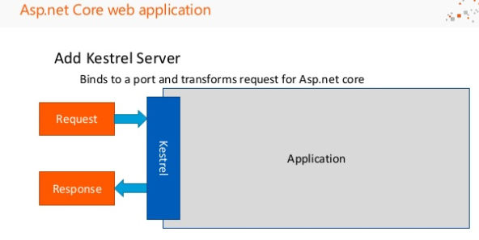

Slide 7
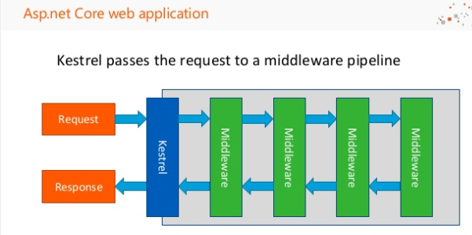

Slide 8
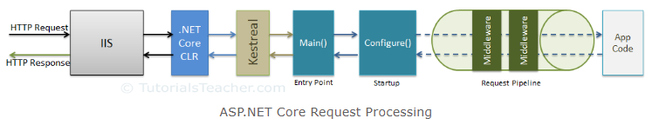
ASP.NET Core - Middleware

Slide 9
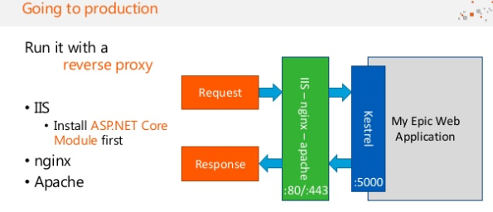

Slide 10
Project

Slide 11
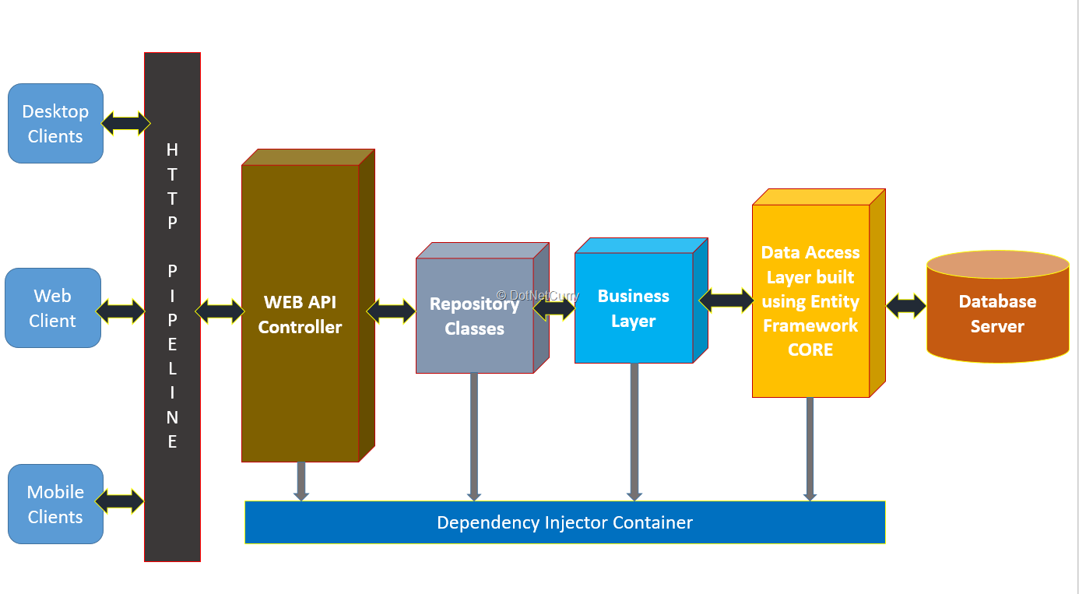
Project Architecture

